Slide 1
BIL 108E Introduction to Scientific and Engineering Computing
ASST. PROF. DR. İPEK AKIN
LINEAR ALGEBRAIC EQUATIONS

Slide 2
INTRODUCTION
Many applications in math, science, and engineering require symbolic operations, which are mathematical operations with expressions that contain symbolic variables (variables that don’t have specific numerical values when the operation is executed). The result of such operations is also a mathematical expression in terms of the symbolic variables.
One simple example involves solving an algebraic equation that contains several variables and solving for one variable in terms of the others.
If a, b, and x are symbolic variables, and , x can be solved in terms of a and b to give x = b/a.

Slide 3
MATLAB has the capability of carrying out many types of symbolic operations. The numerical part of the symbolic operation is carried out by MATLAB exactly, with no approximation of numerical values. For example, the result of
adding
x
x
7
and
is
x and not 0.5833x.
4
3
12
Symbolic operations can be performed by MATLAB once the Symbolic Math Toolbox is installed. The Symbolic Math Toolbox is a collection of MATLAB functions that are used for execution of symbolic operations.

Slide 4
The starting point for symbolic operations is symbolic objects. Symbolic objects are made of variables and numbers that, when used in mathematical expressions, tell MATLAB to execute the expression symbolically.
Typically, the user first defines (creates) the symbolic variables (objects) that are needed, and then uses them to create symbolic expressions that are subsequently used in symbolic operations.
If needed, symbolic expressions can be used in numerical operations

Slide 5
SYMBOLIC OBJECTS AND SYMBOLIC EXPRESSIONS
A symbolic object can be a variable (without a preassigned numerical value), a number, or an expression made of symbolic variables and numbers. A symbolic expression is a mathematical expression containing one or more symbolic objects.
When typed, a symbolic expression may look like a standard numerical expression.
However, because the expression contains symbolic objects, it is executed by MATLAB symbolically.

Slide 6
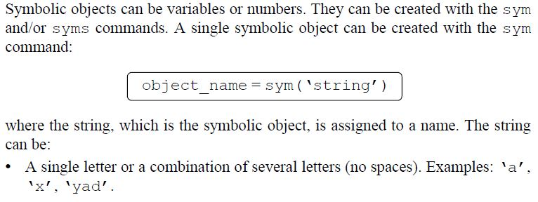
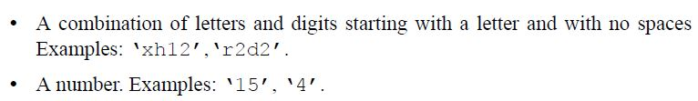
Creating Symbolic Objects

Slide 7
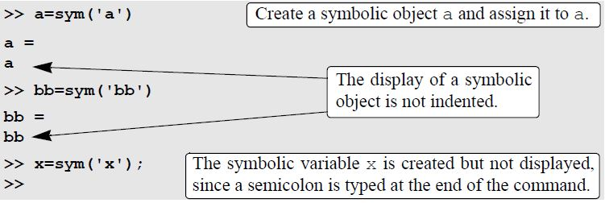

The name of the symbolic object can be different from the name of the variable.
For example:

Slide 8
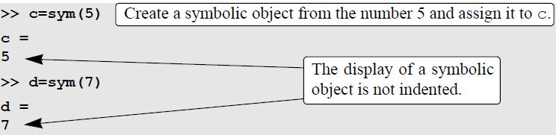

Slide 9
INTRODUCTION
A single algebraic equation can be solved for one variable, and a system of equations can be solved for several variables with the solve function.

Slide 10
Solving a Single Equation
An algebraic equation can have one or several symbolic variables. If the equation has one variable, the solution is numerical. If the equation has several symbolic variables, a solution can be obtained for any of the variables in terms of the others.
The solution is obtained by using the solve command, which has the form
h = solve (eq)
h = solve (eq, var)

Slide 11
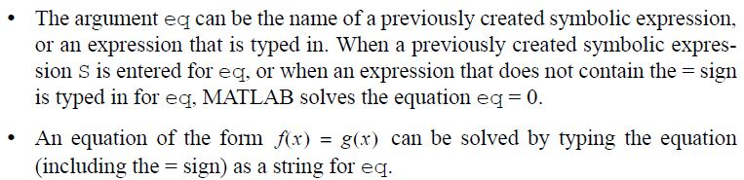
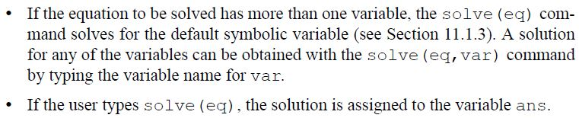
Solving a Single Equation

Slide 12
If the equation has more than one solution, the output h is a symbolic column vector with a solution at each element. The elements of the vector are symbolic objects. When an array of symbolic objects is displayed, each row is enclosed with square brackets

Slide 13
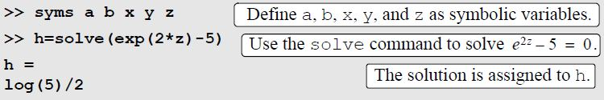

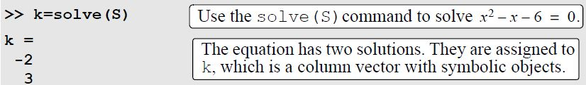
Example

Slide 14
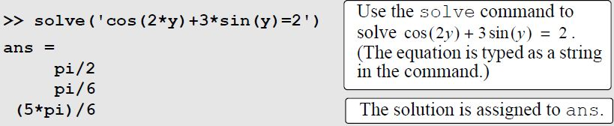

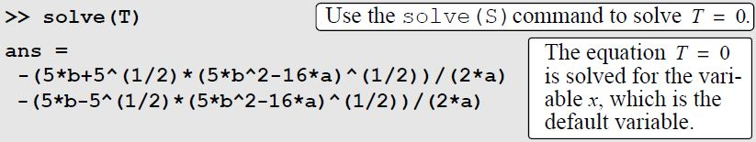


Slide 15
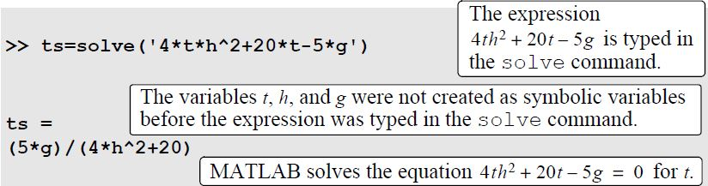
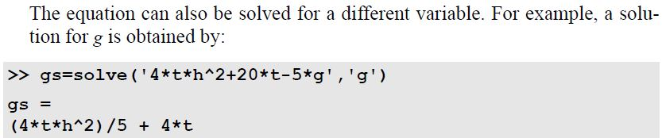
It is also possible to use the solve command by typing the equation to be solved as a string, without having the variables in the equation first created as symbolic objects. However, if the solution contains variables (when the equation has more than one variable), the variables do not exist as independent symbolic objects.

Slide 16
Solving a System of Equations
If the number of equations and the number of variables are the same, the solution is numerical.
If the number of variables is greater than the number of equations, the solution is symbolic for the desired variables in terms of the other variables.
A system of equations (depending on the type of equations) can have one or several solutions;
If the system has one solution, each of the variables for which the system is solved has one numerical value (or expression).
If the system has more than one solution, each of the variables can have several values.

Slide 17
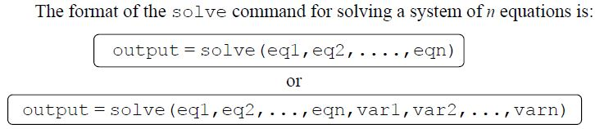
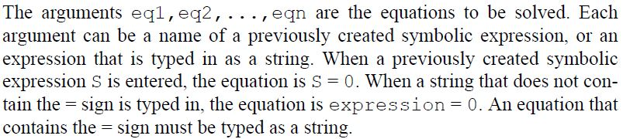

Slide 18
In the first format, if the number of equations n is equal to the number of variables in the equations, MATLAB gives a numerical solution for all the variables.
If the number of variables is greater than the number of equations n, MATLAB gives a solution for n variables in terms of the rest of the variables.
The variables for which solutions are obtained are chosen by MATLAB according to the default order

Slide 19
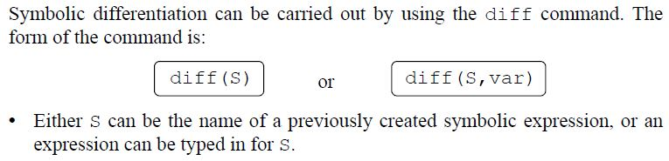
Differentiation
In the diff(S) command, if the expression contains one symbolic variable, the differentiation is carried out with respect to that variable. If the expression contains more than one variable, the differentiation is carried out with respect to the default symbolic variable

Slide 20
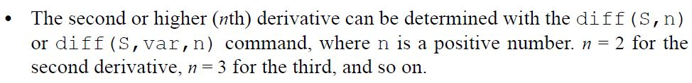
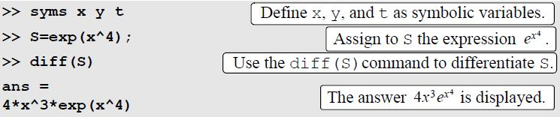
In the diff(S,var) command (which is used for differentiation of expressions with several symbolic variables) the differentiation is carried out with respect to the variable var.

Slide 21

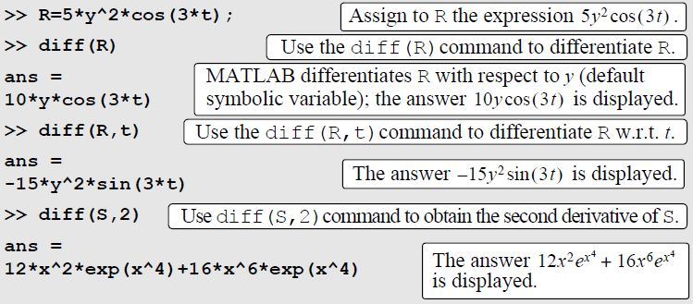

Slide 22
Integration
Symbolic integration can be carried out by using the int command. The command can be used for determining indefinite integrals (antiderivatives) and definite integrals. For indefinite integration the form of the command is:

Slide 23
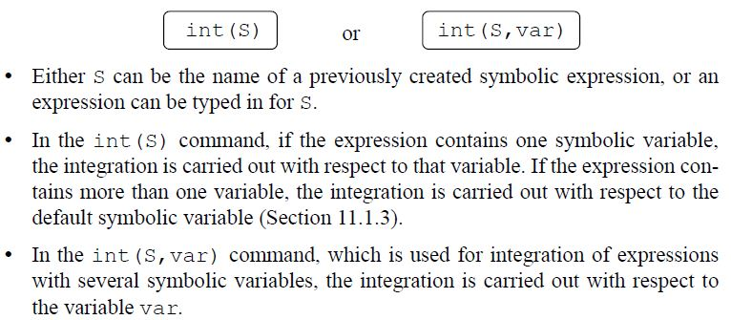
Integration

Slide 24
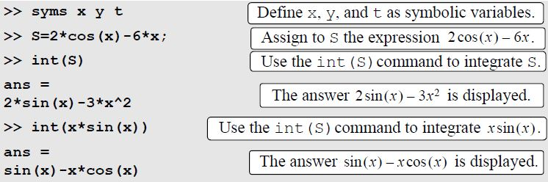

Slide 25
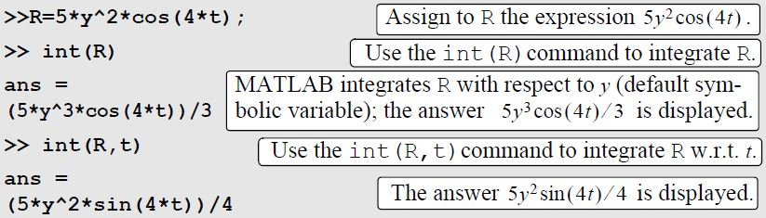

Slide 26
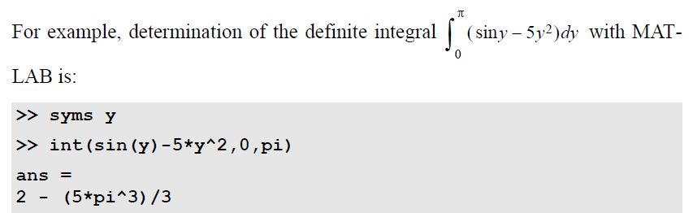
For definite integration the form of the command is:
a and b are the limits of integration. The limits can be numbers or symbolic variables.

Slide 27
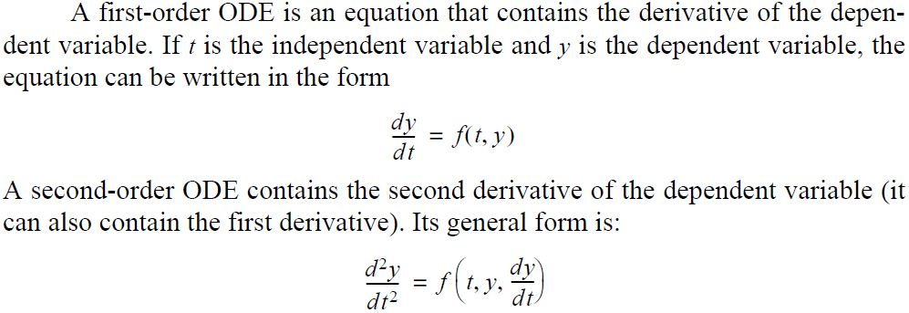
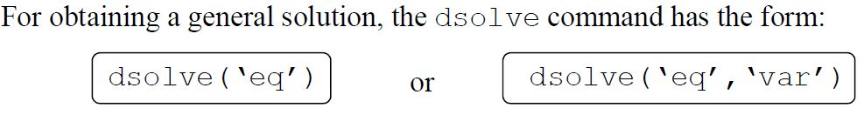
Solving an Ordinary Differential Equation

Slide 28
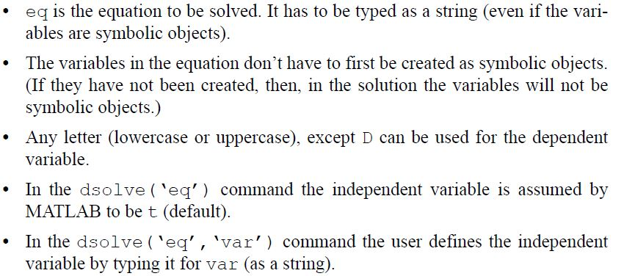

Slide 29
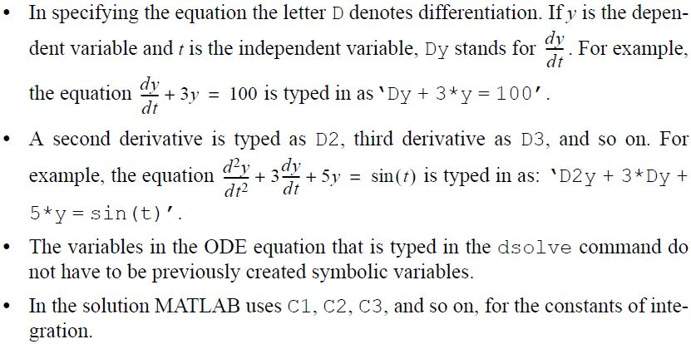

Slide 30
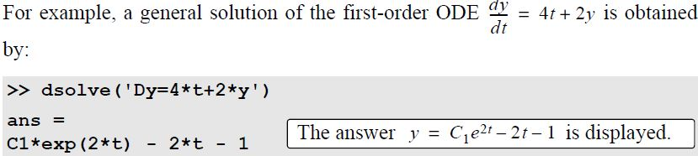
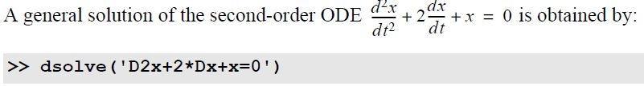

Slide 31
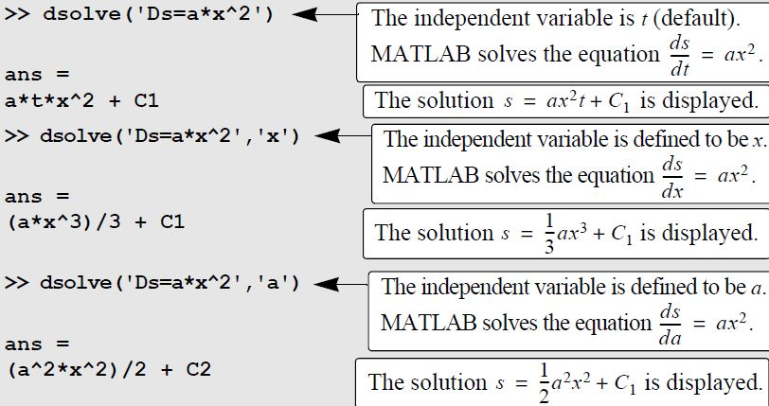

Slide 32
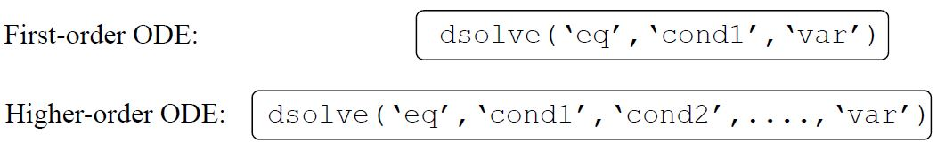
Particular Solution
A particular solution of an ODE can be obtained if boundary (or initial) conditions are specified. A first-order equation requires one condition, a second-order equation requires two conditions, and so on. For obtaining a particular solution, the dsolve command has the form

Slide 33
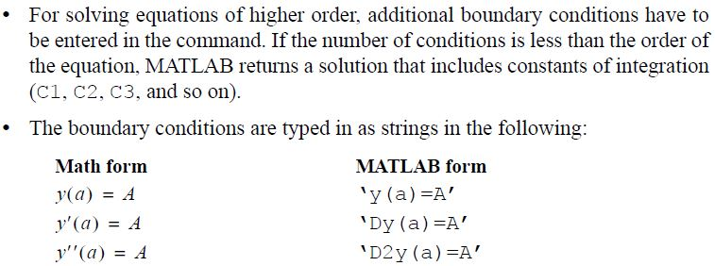

Slide 34
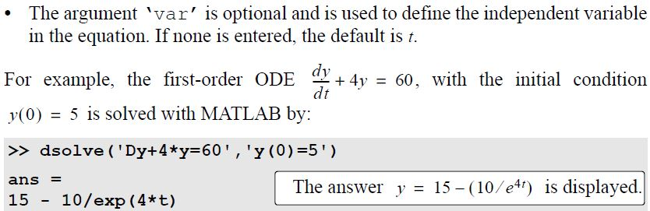

Slide 35
